Slide 1

Automotive Technology:
A Systems Approach, 8e
Chapter 17: Batteries: Theory, Diagnosis, and Service
Rob Thompson and Jack Erjavec, Automotive Technology: A Systems Approach, 8th Edition. © 2025 Cengage. All Rights Reserved. May not be scanned, copied or duplicated, or posted to a publicly accessible website, in whole or in part.

Slide 2
Chapter Objectives (1 of 2)
17.01 Describe how a battery works.
17.02 Identify battery hardware such as cables, holddowns, and cooling systems.
17.03 List the precautions that must be followed when working with or around batteries.
17.04 List and describe the various ways a battery may be rated.

Slide 3
Chapter Objectives (2 of 2)
17.05 Describe the commonly used types of batteries in automotive applications.
17.06 Explain common battery services and testing methods.
17.07 Describe how to jump-start a battery safely.

Slide 4
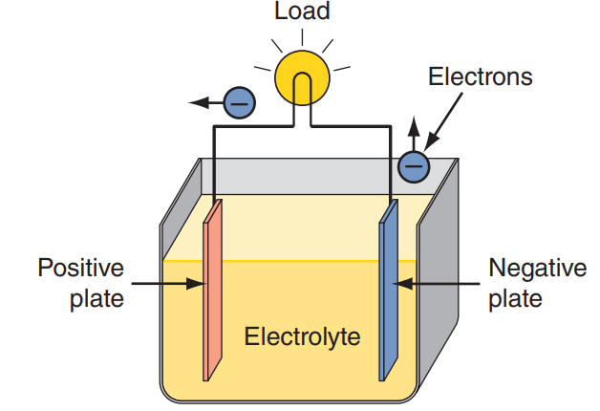
Basic Battery Theory (1 of 3)
17.01 Describe how a battery works.
Batteries convert chemical energy into electrical energy.
Chemical reactions that produce electrons are called electrochemical reaction.
A battery stores DC voltage and releases it when it is connected to a closed circuit.
Inside the battery are two electrodes or plates surrounded by an electrolyte.
Batteries are normally made up of electrochemical cells connected together. One of the plates has an abundance of electrons (negative plate or anode) and the other has a lack of electrons (positive plate or cathode).
The electrons want to move to the positive plate and do so when a circuit connects the two plates.

Slide 5
Basic Battery Theory (2 of 3)
Charging
  Charging a battery restores the chemical nature of the cells.
  To do this, a chemical reaction takes place, causing current flow within the cells.
  Discharging allows for current flow outside the cell.
  To understand the charging process, remember that current flows from a higher potential (voltage) to a lower potential.
  If the voltage applied by an outside source to the battery is higher than the voltage of the battery, current will flow into the battery.
  This means the charging voltage must be higher than the battery’s voltage in order to charge it.

Slide 6
Basic Battery Theory (3 of 3)
Cell and Battery Arrangements
  The voltage produced by an individual battery cell varies with the chemicals and materials used to construct the cell.
    Most cells produce between 1.2 and 4 volts.
  Likewise, there is a limited amount of current available from an individual cell.
  To provide higher battery voltages and increase available current, cells are connected together.
  Cells can be connected in series or in parallel, or both.
  Batteries and battery modules also can be connected in series, parallel, or series-parallel depending on the need.

Slide 7
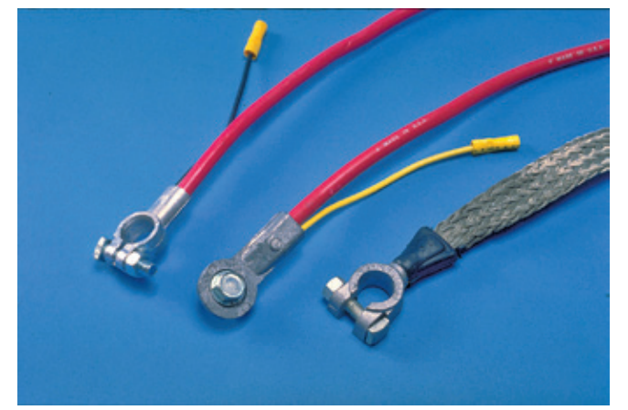
Battery Hardware (1 of 2)
17.02 Identify battery hardware such as cables, holddowns, and cooling systems.
Battery cables connect the battery to the vehicle’s electrical system.
They are large diameter wires because they must be able to carry the required current to operate the starter motor.
The positive cable is normally red, and the negative cable is black.
Various forms of clamps and terminals are used to ensure a good electrical connection at each end of the cable.
Connections must be clean and tight to prevent arcing and corrosion.
The high-voltage cables in nearly all hybrid and electric vehicles are colored orange and have markings on them.

Slide 8
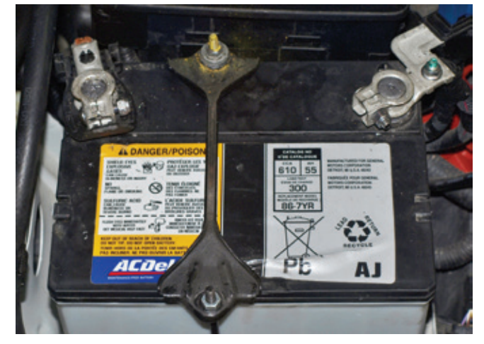
Battery Hardware (2 of 2)
Battery Holddowns
  All batteries must be held securely in the vehicle to prevent damage to the battery and to prevent the terminals from shorting to the vehicle.
  Battery holddowns are made of metal or plastic.

Slide 9
Battery Recycling
The materials used to make a lead-acid battery can be successfully recycled.
Batteries should not be discarded with regular trash because they contain metals and chemicals that are hazardous to the environment.
In 1994, the Rechargeable Battery Recycling Corporation (RBRC) was established to promote recycling of rechargeable batteries in North America.
RBRC is a nonprofit organization that collects batteries from consumers and businesses and sends them to recycling companies.
Collected batteries are sorted by their chemical makeup. Then they are broken apart and their elements separated.
The chemicals or materials are further separated and then collected. The majority of all used lead-acid batteries are recycled. During the recycling process, the lead, plastic, and acids are separated.
The electrolyte (sulfuric acid) can be reused or is discarded after it has been neutralized.
The plastic casing is cut into small pieces, scrubbed, and melted to make new battery cases and other parts.
The lead is also melted and poured into ingots to be used in new batteries.

Slide 10
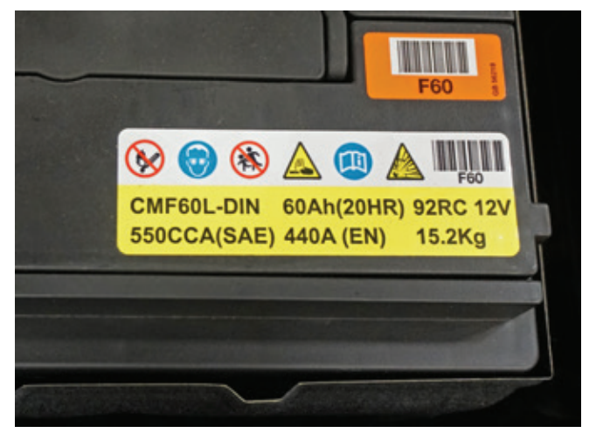
Battery Ratings (1 of 4)
17.04 List and describe the various ways a battery may be rated.
Open circuit voltage is the voltage measured across the battery when there is no load on the battery.
Operating voltage is the voltage measured across the battery when it is under a load.
The available current from a battery is expressed as the battery’s capacity to provide a certain amount of current for a certain amount of time and at a certain temperature. Basically, a capacity rating expresses how much electrical energy a battery can store.
The sticker on some batteries will not reference all possible ratings. However, most will give the BCI group number, CCA, and CA.

Slide 11
Battery Ratings (2 of 4)
BCI Groups
  The BCI or Battery Council International group number defines the physical qualities of a battery.
  This is a standardized system that ensures that a battery in a specific group will have similar physical characteristics.
Cold Cranking Amps
  The cold cranking amps (CCA) rating is the common method of rating starting batteries.
  It expresses the amount of amperage a battery can deliver for 30 seconds at 0 °F (−17.7 °C) without its voltage dropping below a predetermined level.

Slide 12
Battery Ratings (3 of 4)
Cranking Amps
  The cranking amps (CA) rating is similar to CCA and expresses the amount of current a battery can deliver at 32 °F (0 °C) for 30 seconds and maintain voltage at a predetermined level.
Reserve Capacity
  The reserve capacity (RC) rating represents the number of minutes that a fully charged battery can be discharged at 25 amperes before battery voltage drops below 10.5 volts.
Ampere-Hour
  The ampere-hour (AH) rating represents the amount of steady current a fully charged battery can supply for 20 hours at 80 °F (26.7 °C) without the cell’s voltage dropping below a predetermined level.

Slide 13
Battery Ratings (4 of 4)
Some battery manufacturers rate their batteries in watt-hours, which is determined at 0 °F (−17.7 °C) because the battery’s capacity changes with temperature.
The kilowatt rating indicates how much power can flow into or out of a battery at any given instant of time. Kilowatt hours represent the power a battery can deliver or absorb over time.
A 12-volt battery rated at 100-amp hours (20 amps × 5 hours) is rated at 1,200 watt hours or 1.2 kilowatt hours. The HV batteries used in hybrid and electric vehicles are rated in kWh as well.
This rating provides an indication of the range and power available for a particular vehicle and its battery pack.
For example, two vehicles may have batteries of comparable size, such as a Ford Mach-E GT Extended Range (ER) and a Tesla Model S Long Range (LR). Both have approximately 100 kWh battery packs.
However, the range and performance specs for these two vehicles are not the same due to how each vehicle uses the available energy from the pack for propulsion.

Slide 14
Discussion
Consider the various battery ratings:
  Cold cranking amps (CCA)
  Reserve capacity (RC)
  Ampere-hour rating (AH)
Have a class discussion about how each of these are measured or determined and that would relate to selecting a battery for a particular application.

Slide 15
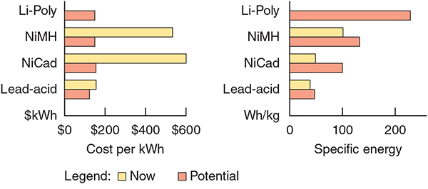
Common Types of Batteries
17.05 Describe the commonly used types of batteries in automotive applications.
There are different types and designs of batteries available.
They have different ratings and service lives.
The primary difference between batteries is the chemicals used in the cells.
The following battery designs are currently in use or are being considered for automotive use in the future:
  Lead-Acid, Nickel-Metal Hydride (NiMH), Lithium-Ion (Li-Ion), and Lithium-Polymer (Li-Poly).

Slide 16
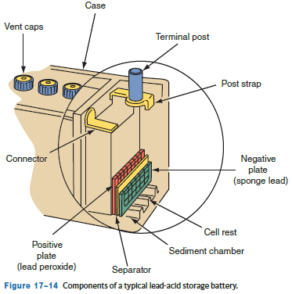
Lead-Acid Batteries (1 of 2)
A lead-acid battery consists of grids, positive plates, negative plates, separators, elements, electrolyte, a container, cell covers, vent plugs, and cell containers.
Plates are typically flat, rectangular components that are either positive or negative, depending on the active material.
The material pasted onto the grids of the negative plates is sponge lead (Pb).
Both plates are very porous and allow the liquid electrolyte to penetrate freely.
An element is a group of positive and negative plates. The plates are formed into a plate group, which holds a number of plates of the same polarity.
The like-charged plates are welded to a plate strap.
Separators are porous plastic sheets that allow for a transfer of ions between plates.

Slide 17
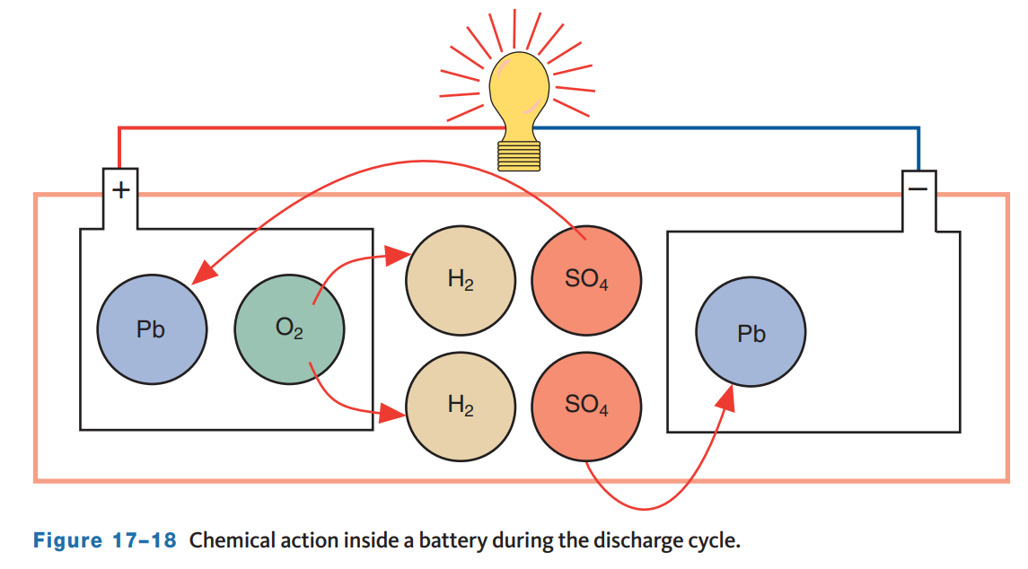
Lead-Acid Batteries (2 of 2)
When a battery discharges, lead in the lead peroxide of the positive plate combines with the sulfate radical (SO₄) to form lead sulfate (PbSO₄).
A similar reaction takes place at the negative plate. The lead (Pb) of the negative plate combines with the SO₄ to also form lead sulfate (PbSO₄), a neutral and inactive material.
During this chemical reaction, the extra oxygen from the lead peroxide and the hydrogen from the sulfuric acid combine to form water (H₂O).
The recharging process is the reverse of discharging.
Electricity from an outside source, such as the generator or a battery recharger, is forced into the battery.
As the sulfate (SO4) leaves both plates, it combines with hydrogen in the electrolyte to form sulfuric acid (H₂SO₄).

Slide 18
Lead-Acid Battery Uses
Hybrids and EVs have a 12-volt auxiliary battery to power the 12-volt system and to bring the HV system online. These batteries are not intended to be used to power starter motors and tend to have low-capacity ratings.
Some vehicles with automatic stop/start systems and some luxury vehicles have two batteries. The primary is the starting battery, and the second auxiliary battery is used to help handle increased electrical loads during engine shut down.
Deep cycle batteries are designed to go through many charge and discharge cycles. They are not used as the primary batteries in automotive applications but are used extensively in campers, recreational vehicles, and some marine applications.
A low-maintenance battery is a heavy-duty version of a normal lead-acid battery. Many of the parts are thicker and made with different, more durable materials. Low-maintenance batteries have vent holes and caps, which allow water to be added to the cells.
Maintenance-free batteries are similar in construction but made with different plate materials. This type of battery experiences little gassing during discharge and charge cycles, therefore, maintenance-free batteries do not have external holes or caps.

Slide 19
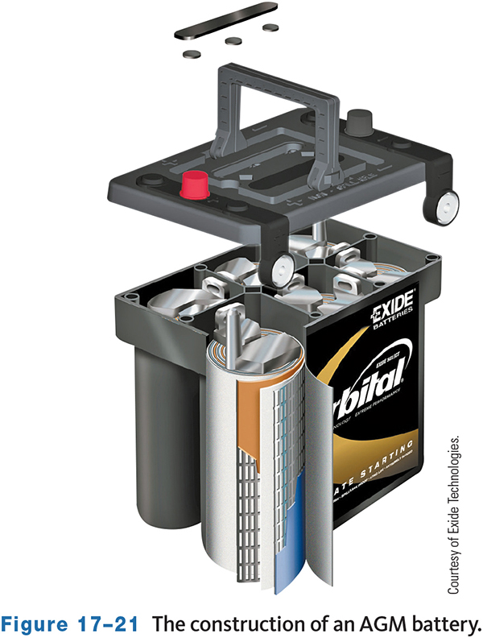
Recombination Batteries
A recombination or recombinant battery (gel battery) is a completely sealed maintenance-free battery that uses a gel-type electrolyte.
Gassing is minimized, and vents are not needed.
During normal use, hydrogen and oxygen within the battery are captured and recombined to form water within the electrolyte. This eliminates the need to ever add water to the battery.
An absorbed glass mat (AGM) battery is a common example of a recombinant battery. The electrolyte in AGM batteries is held in moistened fiberglass matting. The matting is sandwiched between the battery’s plates, where it doubles as a vibration dampener. Rolls of high-purity lead plates are tightly compressed into six cells.
Another recombinant battery is the valve-regulated lead-acid (VRLA) battery.

Slide 20
Lithium-Ion Batteries
Drop-in replacement lithium-ion (LI) batteries are now available from the aftermarket.
These are dry cell batteries that use a powdered electrolyte, which removes the danger of acid spills and makes them safer to handle.
There are several other advantages to installing a lithium-ion battery, including:
  Weight savings. Most replacement LI batteries weigh up to 70 percent less than the lead-acid batteries they replace.
  Longer life spans. LI batteries are rated for 5,000 to 7,000 cycles, or approximately three times the life span of a lead-acid battery.
  Built-in jump starting. If the battery does go dead, LI batteries have internal battery energy management systems (BEMs) that maintain a power reserve to start the engine.
  Increased power. Because LI battery cells have a greater energy density compared to lead-acid cells, cold cranking ratings range from 1,500 to 2,000 amps. LI batteries can deliver current for longer periods of time compared to similar lead-acid batteries.

Slide 21
Factors Affecting Battery Life
All storage batteries have a limited service life; lead-acid batteries are typically good for 3 to 7 years. However, many conditions can shorten this time.
The water in the electrolyte is lost due to evaporation during hot weather and gassing during charging.
The battery freezing when it is very cold and its charge is low will ruin a battery.
When the battery is allowed to get too hot, the water in the electrolyte can evaporate. Batteries used in hot climates tend to have shorter service lives and should have their electrolyte level checked very frequently if possible.
Battery corrosion is commonly caused by spilled electrolyte or electrolyte condensation from gassing.
Overcharging can also cause excessive heat, which can oxidize the positive plate grid material and even buckle the plates, resulting in a loss of cell capacity and early failure.
The charging system might not fully recharge the battery due to a fault in the system. This causes the battery to operate in a partially discharged condition which results in sulfation of the plates and ruining the battery.

Slide 22
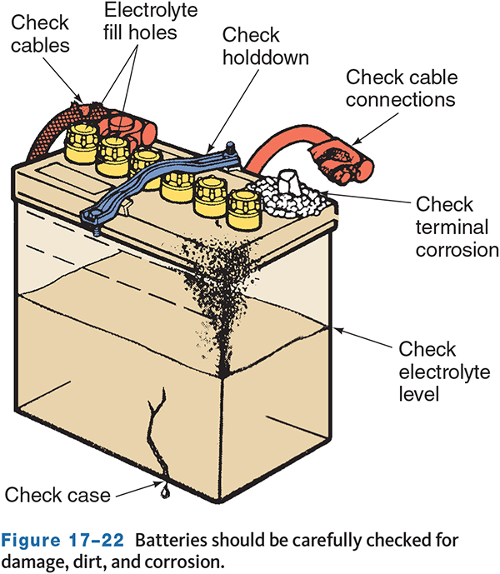
Inspection
Testing a lead-acid battery should begin with a thorough inspection of the battery and its terminals.
The following items should be checked:
  Check the age of the battery by looking at the date code on the battery.
  Check the condition of the case. A damaged battery should be replaced.

Slide 23
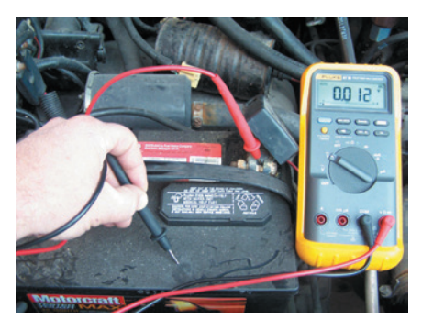
Servicing and Testing Batteries (1 of 4)
17.06 Explain common battery services and testing methods.
Battery Leakage Test
  To perform a battery leakage test, set a voltmeter to a low DC volt range.
  Connect the negative lead to the negative post.
  Then move the meter’s positive lead across the top and sides of the case.
  If some voltage is read, current is leaking from the battery.

Slide 24
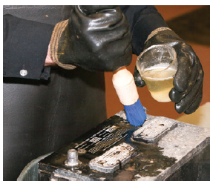
Servicing and Testing Batteries (2 of 4)
Before removing the battery terminals or the battery, always neutralize any accumulated corrosion on the terminals and other metal parts. Apply a solution of baking soda and water or ammonia and water.
Do not splash the solution or corrosion onto the vehicle’s paint, metal, or rubber parts, or onto your hands and face.
Make sure the solution cannot enter the battery’s cells.
A stiff-bristle brush is ideal for removing heavy buildup.
Dirt and accumulated grease can be removed with a detergent solution or solvent. After cleaning, rinse the battery and terminals with clean water.
Dry everything with a rag or low-pressure compressed air.
To clean the inside surfaces of the battery terminals, remove the cables. Always begin with removing the ground cable first.

Slide 25
Servicing and Testing Batteries (3 of 4)
While not as common with modern starting batteries, batteries with removable vent caps should have the specific gravity of the electrolyte checked using a hydrometer.
The electrolyte of a fully charged battery is usually about 64 percent water and 36 percent sulfuric acid.
This corresponds to a specific gravity of 1.270. Pure water has a specific gravity of 1.000, whereas battery electrolyte should have a specific gravity of 1.260 to 1.280 at 80 °F (26.7 °C).
The specific gravity of the electrolyte decreases as the battery discharges. This is why measuring the specific gravity of the electrolyte can be a good indicator of how much charge a battery has lost.
The electrolyte’s specific gravity can be measured with a battery hydrometer that uses a glass float in a glass tube to measure the electrolyte’s specific gravity. When filled with the electrolyte, the float bobs in the electrolyte. The depth at which the float sinks indicates the electrolyte’s relative weight compared to water.

Slide 26
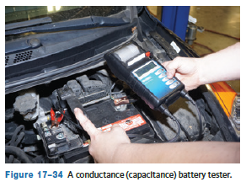
Servicing and Testing Batteries (4 of 4)
Battery capacitance testing is the more common method of testing currently.
The conductance test can be used to detect cell defects, shorts, normal aging, and open circuits, which can cause the battery to fail.
The tester measures the battery’s ability to conduct current which provides a reliable indication of a battery’s condition and is correlated to battery capacity.
A capacitance test is the only test that will yield accurate measurements of a battery with low SOC.
The tester creates a small signal that is sent through the battery and measures a portion of the AC response.

Slide 27
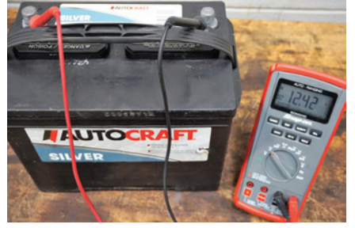
Open Circuit Voltage Test
An open circuit voltage check measures the voltage output of a battery without a load.
As the battery is charged or discharged, slight changes occur in the battery’s voltage.
Therefore, battery voltage with no load can give an indication of the SOC.
To check a battery’s open voltage, the temperature should be between 60 °F and 100 °F (15.6 °C and 37.8 °C).
A fully charged 12-volt battery should have a terminal voltage of 12.6 volts. However, sealed AGM and other gel cell batteries may have a slightly higher voltage.
If the test indicates an SOC below 75 percent, recharge the battery and perform the capacity test to determine battery condition.

Slide 28
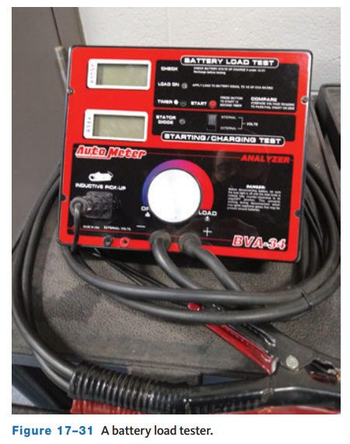
Battery Load Test
The capacity or load test determines how well a battery will perform under a load.
A battery load tester or a volt/ampere tester (VAT) is used for this test.
A VAT can be used to test batteries, starting systems, and charging systems. These testers have a voltmeter, an ammeter, and a carbon pile.
The carbon pile is a variable resistor. When the tester is attached to the battery and operated, the carbon pile draws current from the battery. The ammeter reads the amount of current draw. The maximum current draw from the battery, with acceptable voltage, is compared to the rating of the battery. Some battery load testers and VATs automatically adjust the load or carbon pile.

Slide 29
Three-Minute Charge Test
The 3-minute charge test, also called a battery sulfation test, is used to determine if a traditional lead-acid battery has sulfated plates.
Do not use the 3-minute charge test on AGM batteries as the voltage and current supplied can damage or destroy the batteries.
Sulfation interferes with the battery’s ability to accept a charge and to deliver current.
This may be due to a generator problem, excessive voltage drop in the charging circuit or battery cables, or insufficient generator belt tension.
A parasitic draw that discharges the battery can also be battery sulfation.
To perform this test:
  Disconnect the negative battery cable if the battery is installed in the vehicle.
  Connect a battery charger and set the charging rate of 30 to 40 amps.
  Use a voltmeter to monitor battery voltage during the charge.
  At the end of the 3 minutes, with the charger still set on 30 to 40 amps, note the battery voltage.
  Voltage should not exceed 15.5 volts.

Slide 30
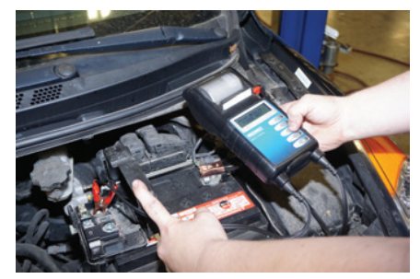
Battery Capacitance Test
A fully charged new battery will have a high conductance reading anywhere from 110 percent to 140 percent of its CCA rating.
As a battery ages, the plate surface can sulfate or shed active material, which will lower its capacity and conductance.
When a battery has lost a significant percentage of its cranking ability, the conductance reading will fall well below its rating and indicate that the battery should be replaced.
Many conductance testers display a code when the test is completed. Identify what the code indicates before taking any action in response to the results.
If the battery being tested is under warranty, the tester may produce a unique battery test code which is used for completing the warranty claim.

Slide 31
Knowledge Check (1 of 2)
What type of battery test and battery tester tests a battery under load?

Slide 32
Knowledge Check Answer (1 of 2)
Answer:
A load test determines how well a battery will perform under a load.
A battery load tester or a volt/ampere tester (VAT) is used for this test.

Slide 33
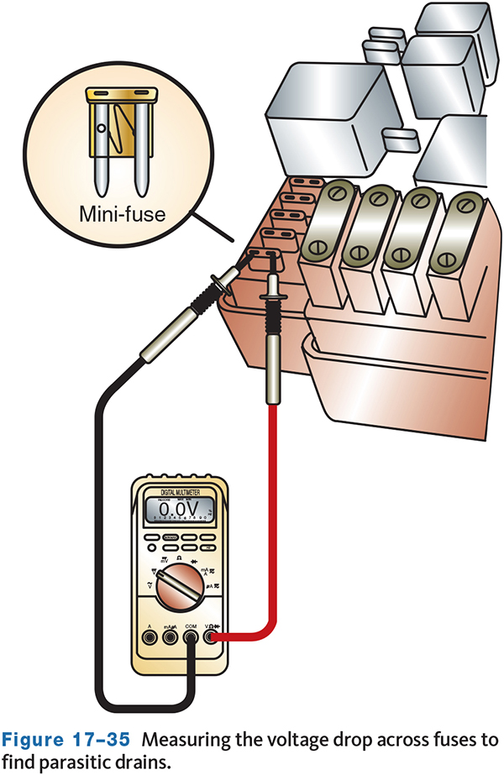
Battery Drains
Many of today’s vehicles have parasitic loads.
Parasitic loads are current drains that exist when the key is off.
This drain is caused by systems that operate when the engine is not running.
A parasitic load is normal unless it exceeds specifications.
These drains can cause a battery to lose its charge overnight or after a few days.
The drains can also deplete the battery and cause various driveability problems.
A constantly low battery will also have a shortened service life.
A drain of 30 mA is normal for most. Excessive current drains are caused by problems, and they will run down a battery.

Slide 34
HEV and EV 12-Volt Auxiliary Battery Testing
All HEVs and EVs still use a low-voltage (12 V to 16 V) battery to power up the electrical system.
These batteries tend to be of smaller capacity, 300–400 CCAs, since they are not used to crank the engine.
Most manufacturers recommend using a conductance tester on the auxiliary battery.
Simply program the tester for the battery type, rating, and test.
Replace the battery if it cannot supply the necessary voltage and current.

Slide 35
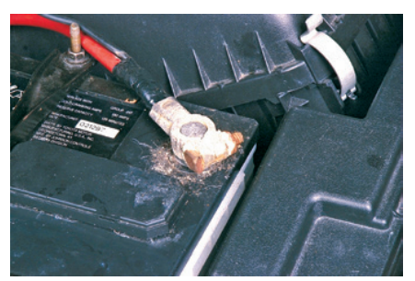
Battery Cables
A battery’s performance is affected by its cables.
Poor connections and corrosion at the terminals and cable ends will cause voltage drops, which will reduce the available voltage at all of the vehicle’s systems.
The terminals may also be out of shape, loose, or damaged; these will cause excessive resistance.
All battery cables should be inspected and tested for excessive voltage drops.
During the inspection, heavily corroded terminals will be obvious, but corrosion can form a nearly invisible barrier between the battery terminals and cables.
This is why conducting a voltage drop test is preferred.

Slide 36
Battery Chargers (1 of 2)
Constant voltage chargers provide a specific amount of voltage to the battery.
The current varies with the voltage of the battery. When the potential difference between the charger’s voltage and the battery’s voltage is great, the current is high.
As the battery charges, the charging current drops off. A constant current charger varies the voltage applied to the battery in order to maintain a constant current.
There are many “smart” or “intelligent” battery chargers available which are designed to charge a battery in three basic steps: bulk, absorption, and float.
  During bulk charging, current is sent to the battery at a maximum safe rate until the voltage reaches approximately 80 percent of its capacity.
  Once the voltage reaches that level, the charger begins the absorption step. During this time, charging voltage is held constant while the current changes according to the battery’s voltage.
  Once the battery is fully charged, the charger switches to the float step. During this step, the charger supplies a constant voltage that is slightly more than the battery’s voltage. This is a maintenance charge and is intended to keep a battery charged.

Slide 37
Battery Chargers (2 of 2)
Fast charging quickly charges a battery by supplying large amounts of voltage and current. Although the battery is charged quickly, it can also overheat and even explode it if it is not closely monitored.
  Batteries must be in good condition to accept a fast charge. Sulfation of the battery’s plates can lead to excessive gassing, boiling, and heat buildup during fast charging.
Slow or trickle charging applies low current to the battery.
  Slow charging is slow and takes quite some time to fully charge a battery.
  However, since low current is applied to the battery, it is unlikely that the battery will overheat.
  Slow charging is the only safe way to charge sulfated batteries. The type of battery should always be considered before fast charging or slow charging a battery.
  Always charge a battery in a well-ventilated area away from sparks and open flames.
  The charger should be turned off before connecting or disconnecting the leads to the battery.

Slide 38
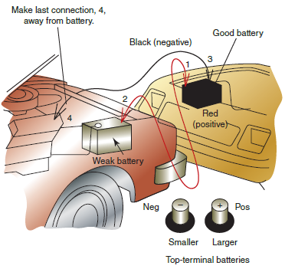
Jump-Starting
If the vehicle will not start, several things can be the cause. If the engine does not crank over, the battery may be discharged or dead.
If the dash or headlights dim severely or go out when trying to crank the engine, suspect the battery is discharged. If the lights do not come on at all, the battery may be completely dead or there may be a very poor battery connection.
Before attempting to jumpstart a vehicle, inspect the battery connections and if possible, measure battery voltage.
A discharged battery should be recharged with a battery charger instead of jump-started. It is not recommended that a vehicle be jump-started.

Slide 39
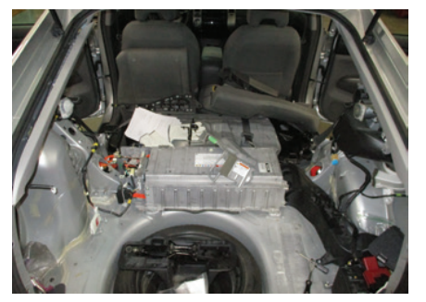
Replacing an HV Battery
Replacing HV battery pack should only be performed by a shop with the tools and equipment to safely and correctly perform the repair.
You should never attempt to service or replace high-voltage components without the proper training and equipment.
For HEVs such as the Prius, removing the HV battery pack requires disassembly of much of the rear interior space.
For most EVs, removing the battery requires special lifting equipment designed to safely support the weight and bulk of the battery pack.
Removing the pack will likely involve draining the battery cooling system and possibly discharging the A/C system.

Slide 40
Knowledge Check (2 of 2)
Replacing HV battery pack should only be performed by a shop with the tools and equipment to safely and correctly perform the repair. Which two systems may need to be drained or emptied to perform an HV battery pack replacement?

Slide 41
Knowledge Check Answer (2 of 2)
Removing the pack will likely involve draining the battery cooling system and possibly discharging the A/C system.

Slide 42
Chapter Reflection
Please take a moment consider battery theory, diagnosis, and service. Then respond to the following questions in one or two paragraphs. Use 150–200 words in your reflection.
Did anything in this chapter come at a complete surprise regarding batteries? Describe something new that you learned.
Considering all you have learned, do you feel you are prepared to perform battery diagnosis and service in the shop environment? How can you better prepare?

